Slide 1
Blazor Server Authentication using Auth0
Anju munoth

Slide 2
Authentication in Blazor Server
Blazor server is a stateful service.
In normal operation, the Blazor server application running on the server maintains a SignalR connection to the user's browser, and sends diff updates to the browser.
However, authentication for SignalR occurs when the connection is established, so you typically need to perform your authentication outside of the normal Blazor Server workflow.

Slide 3
The default .NET templates for Blazor Server use Razor Pages and ASP.NET Core Identity to handle authentication.
This is exactly the same as for a typical ASP.NET Core MVC or Razor Pages app, so whether you use Visual Studio or the .NET CLI templates (dotnet new blazorserver) you have all the normal options for authentication, namely:
None: No authentication
Individual: Individual authentication using ASP.NET Core Identity
IndividualB2C: Individual authentication with Azure AD B2C
SingleOrg: Organizational authentication (Microsoft account) for a single tenant
MultiOrg: Organizational authentication (Microsoft account) for multiple tenants
Windows: Windows authentication

Slide 4
Using Auth0 for authentication
Auth0 is an identity provider that you can use to provide user management and authentication for your applications.
By using an external login provider such as Auto0 (or Azure AD B2C), you delegate responsibility for the "login process" to a third party.
That means you get benefits such as "paswordless" login, compromised password checks, social logins, and WebAuthn support.
More importantly, you don't have to worry about losing user passwords, as you don't have them!

Slide 5
Using Auth0 for authentication
Using an external identity provider (such as Auth0) is relatively simple with ASP.NET Core, as long as the provider implements OpenId Connect (which most do).
With this approach, whenever you need to login to your app, you redirect the user to Auth0 to do the actual sign-in.
Once the user has signed in, they're redirected to a callback page in your app.
Your app then talks directly to Auth0 to obtain the authentication details.

Slide 6
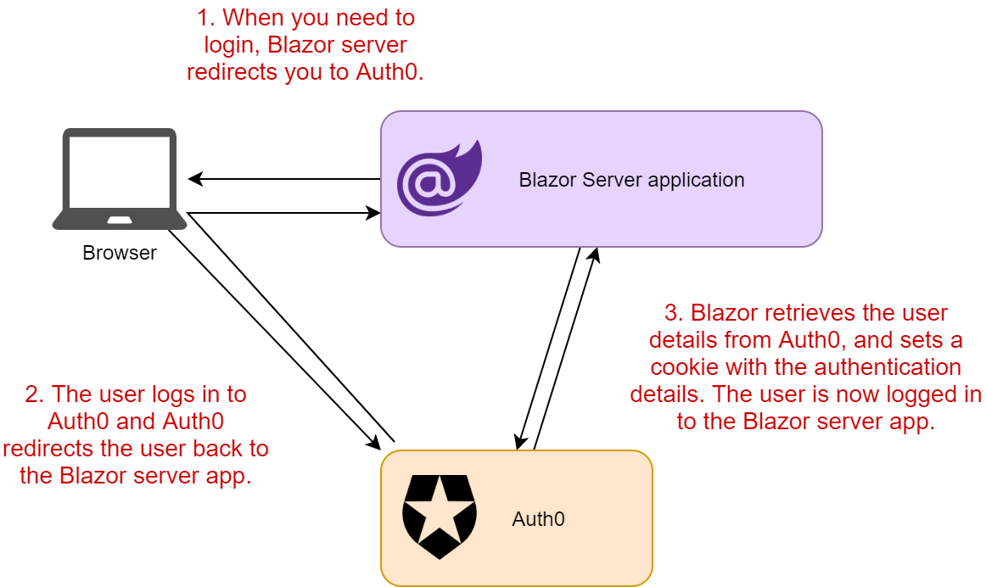

Slide 7
Building a Blazor Server Application
Need to ensure you have installed the right tools on your machine. In particular, you need .NET 5.0 SDK or above
Create a basic Blazor Server project
Securing the Application with Auth0
Now you have a working Web application implemented as a Blazor Server application. In order to secure this application, you will have to integrate it with Auth0 services.

Slide 8
Creating the Auth0 application
The first step to secure your Blazor Server application is to access the Auth0 Dashboard in order to create your Auth0 application.
If you haven't created an Auth0 account, you can sign up for a free one now.
Once in the dashboard, move to the Applications section and follow these steps:
Click on Create Application
Provide a friendly name for your application and choose Regular Web Applications as an application type
Finally, click the Create button

Slide 9
Settings for Auth0
After the application has been created, move in the Settings tab and take note of your Auth0 domain, your client id, and your client secret.
Then, in the same form, assign the value https://localhost:5001/callback to the Allowed Callback URLs field and the value https://localhost:5001/ to the Allowed Logout URLs field.
The first value tells Auth0 which URL to call back after the user authentication.
The second value tells Auth0 which URL a user should be redirected to after their logout.
Click the Save Changes button to apply them.

Slide 10
Configuring your Blazor application
Open the appsettings.json file in the root folder of your Blazor Server project and replace its content with the following:
// appsettings.json
{
"Logging": {
"LogLevel": {
"Default": "Information",
"Microsoft": "Warning",
"Microsoft.Hosting.Lifetime": "Information"
}
},
"AllowedHosts": "*",
"Auth0": {
"Domain": "YOUR_AUTH0_DOMAIN",
"ClientId": "YOUR_CLIENT_ID",
"ClientSecret": "YOUR_CLIENT_SECRET"
}
}
Replace the placeholders YOUR_AUTH0_DOMAIN, YOUR_CLIENT_ID, and YOUR_CLIENT_SECRET with the respective values taken from the Auth0 dashboard.

Slide 11
Integrating with Auth0
Now, install the Microsoft.AspNetCore.Authentication.OpenIdConnect library by typing the following command in a terminal window:
dotnet add package Microsoft.AspNetCore.Authentication.OpenIdConnect
Or by adding it as a nuget package

Slide 12
Startup.cs namespacs
After the installation is complete, open the Startup.cs file and add the following using section with the following code:
using Microsoft.AspNetCore.Http;
using Microsoft.AspNetCore.Authentication.OpenIdConnect;
using Microsoft.AspNetCore.Authentication.Cookies;

Slide 13
Now, replace the definition of the ConfigureServices() method with the following code:
// Startup.cs
public void ConfigureServices(IServiceCollection services)
{
services.AddRazorPages();
services.AddServerSideBlazor();
services.Configure<CookiePolicyOptions>(options =>
{
// This lambda determines whether user consent for non-essential cookies is needed for a given request.
options.CheckConsentNeeded = context => true;
options.MinimumSameSitePolicy = SameSiteMode.None;
});
// Add authentication services
services.AddAuthentication(options =>
{
options.DefaultAuthenticateScheme = CookieAuthenticationDefaults.AuthenticationScheme;
options.DefaultSignInScheme = CookieAuthenticationDefaults.AuthenticationScheme;
options.DefaultChallengeScheme = CookieAuthenticationDefaults.AuthenticationScheme;
})

Slide 14
Now, replace the definition of the ConfigureServices() method with the following code:
// Startup.cs
.AddCookie()
.AddOpenIdConnect("Auth0", options =>
{
// Set the authority to your Auth0 domain
options.Authority = $"https://{Configuration["Auth0:Domain"]}";
// Configure the Auth0 Client ID and Client Secret
options.ClientId = Configuration["Auth0:ClientId"];
options.ClientSecret = Configuration["Auth0:ClientSecret"];
// Set response type to code
options.ResponseType = "code";
// Configure the scope
options.Scope.Clear();
options.Scope.Add("openid");
// Set the callback path, so Auth0 will call back to http://localhost:3000/callback
// Also ensure that you have added the URL as an Allowed Callback URL in your Auth0 dashboard
options.CallbackPath = new PathString("/callback");
// Configure the Claims Issuer to be Auth0
options.ClaimsIssuer = "Auth0";

Slide 15
Now, replace the definition of the ConfigureServices() method with the following code:
// Startup.cs
options.Events = new OpenIdConnectEvents
{ // handle the logout redirection
OnRedirectToIdentityProviderForSignOut = (context) =>
{ var logoutUri = $"https://{Configuration["Auth0:Domain"]}/v2/logout?client_id={Configuration["Auth0:ClientId"]}";
var postLogoutUri = context.Properties.RedirectUri;
if (!string.IsNullOrEmpty(postLogoutUri))
{
if (postLogoutUri.StartsWith("/"))
{
var request = context.Request; // transform to absolute
postLogoutUri = request.Scheme + "://" + request.Host + request.PathBase + postLogoutUri;
}
logoutUri += $"&returnTo={ Uri.EscapeDataString(postLogoutUri)}"; }
context.Response.Redirect(logoutUri);
context.HandleResponse();
return Task.CompletedTask; } }; });
services.AddHttpContextAccessor(); }

Slide 16
Also, replace the Configure() method in the Startup.cs file with the following definition:
// Startup.cs
public void Configure(IApplicationBuilder app, IWebHostEnvironment env)
{
if (env.IsDevelopment())
{ app.UseDeveloperExceptionPage(); }
else
{
app.UseExceptionHandler("/Error");
app.UseHsts();
}
app.UseHttpsRedirection();
app.UseStaticFiles();
app.UseRouting();
app.UseCookiePolicy();
app.UseAuthentication();
app.UseAuthorization();
app.UseEndpoints(endpoints =>
{
endpoints.MapBlazorHub();
endpoints.MapFallbackToPage("/_Host");
}); }

Slide 17
Securing the server side
In order to prevent unauthorized users from accessing the server-side functionalities of your application, you need to protect them. So, open the Index.razor file in the Pages folder and add the Authorize attribute as shown in the following
// Pages/Index.razor
@page "/"
@attribute [Authorize]
<h1>Hello, world!</h1>
Welcome to your new app.

Slide 18
Creating login and logout endpoints
As said before, in the Blazor Server hosting model, the communication between the client side and the server side does not occur over HTTP, but through SignalR.
Since Auth0 uses standard protocols like OpenID and OAuth that rely on HTTP, you need to provide a way to bring those protocols on Blazor.
To solve this issue, you are going to create two endpoints, /login and /logout, that redirect requests for login and for logout to Auth0.
Two standard Razor pages respond behind these endpoints.

Slide 19
Login.razor
So, add the Login razor page to the project
This command creates two files in the Pages folder: Login.cshtml and Login.cshtml.cs.
Open the Login.cshtml.cs file in the Pages folder and replace its content with the following:
code starts the challenge for the Auth0 authentication scheme you defined in the Startup class

Slide 20
// Pages/Login.cshtml.cs
using System.Threading.Tasks;
using Microsoft.AspNetCore.Authentication;
using Microsoft.AspNetCore.Mvc.RazorPages;
namespace QuizManager.Pages
{
public class LoginModel : PageModel
{
public async Task OnGet(string redirectUri)
{
await HttpContext.ChallengeAsync("Auth0", new AuthenticationProperties
{
RedirectUri = redirectUri
});
}
}
}

Slide 21
Logout.razor
add the Logout page
Similarly to the previous case, you will get two new files in the Pages folder: Logout.cshtml and Logout.cshtml.cs.
Replace the content of the Logout.cshtml.cs file with the following code:
code closes the user's session on Auth0.

Slide 22
// Pages/Logout.cshtml.cs
using System.Threading.Tasks;
using Microsoft.AspNetCore.Authentication;
using Microsoft.AspNetCore.Authentication.Cookies;
using Microsoft.AspNetCore.Mvc.RazorPages;
namespace QuizManager.Pages
{
public class LogoutModel : PageModel
{
public async Task OnGet()
{
await HttpContext.SignOutAsync("Auth0", new AuthenticationProperties { RedirectUri = "/" });
await HttpContext.SignOutAsync(CookieAuthenticationDefaults.AuthenticationScheme);
}
}
}

Slide 23
Open the App.razor file in the root folder of the project and replace its content with the following markup:
// App.razor
<CascadingAuthenticationState>
<Router AppAssembly="@typeof(Program).Assembly">
<Found Context="routeData">
<AuthorizeRouteView RouteData="@routeData" DefaultLayout="@typeof(MainLayout)">
<Authorizing>
<p>Determining session state, please wait...</p>
</Authorizing>
<NotAuthorized>
<h1>Sorry</h1>
<p>You're not authorized to reach this page. You need to log in.</p>
</NotAuthorized>
</AuthorizeRouteView>
</Found>
<NotFound>
<p>Sorry, there's nothing at this address.</p>
</NotFound>
</Router>
</CascadingAuthenticationState>

Slide 24
Create a razor component by adding an AccessControl.razor file in the Shared folder with the following content:
// Shared/AccessControl.razor
<AuthorizeView>
<Authorized>
<a href="logout">Log out</a>
</Authorized>
<NotAuthorized>
<a href="login?redirectUri=/">Log in</a>
</NotAuthorized>
</AuthorizeView>
This component uses the Authorized component to let the authorized users see the Log out link and the NotAuthorized component to let the unauthorized users access the Log in link.
Both links point to the endpoints you created before.
In particular, the Log in link specifies the home page as the URI where to redirect users after authentication.

Slide 25
The final step is to put this component in the top bar of your Blazor application. So, replace the content of the MainLayout.razor file with the following content:
// Shared/MainLayout.razor
@inherits LayoutComponentBase
<div class="page">
<div class="sidebar">
<NavMenu />
</div>
<div class="main">
<div class="top-row px-4">
<AccessControl /> //👈 new markup
<a href="https://docs.microsoft.com/aspnet/" target="_blank">About</a>
</div>
<div class="content px-4">
@Body
</div>
</div>
</div>

Slide 26
Blazor application is accessible just to authorized users.
When users click the Log in link, they will be redirected to the Auth0 Universal Login page for authentication.
After authentication completes, they will be back to the home page of your application and will be able to see the various pages

Slide 27
Accessing the user profile
Once you add authentication to your Blazor Server application, you may need to access some information about the authenticated user, such as their name and picture.
You can do it by explicitly requesting the user profile to Auth0.
This additional request is just a new scope of the OpenID Connect protocol, as shown by the following code in ConfigureServices:
.AddOpenIdConnect("Auth0", options =>
{
// ...existing code...
// Configure the scope
options.Scope.Clear();
options.Scope.Add("openid");
options.Scope.Add("profile"); //👈 new code
// ...existing code...
});

Slide 28
This change enables you to access the user's data and show them on a page. So, let's change the content of the Index.razor component as follows:
// Pages/Index.razor
<img src="@Picture">
@code {
private string Username = "Anonymous User";
private string Picture = "";
protected override async Task OnInitializedAsync()
{
var state = await AuthState.GetAuthenticationStateAsync();
Username = state.User.Claims .Where(c => c.Type.Equals("name")) .Select(c => c.Value) .FirstOrDefault() ?? string.Empty;
Picture = state.User.Claims .Where(c => c.Type.Equals("picture"))
.Select(c => c.Value) .FirstOrDefault() ?? string.Empty;
await base.OnInitializedAsync(); }}

